Slide 1


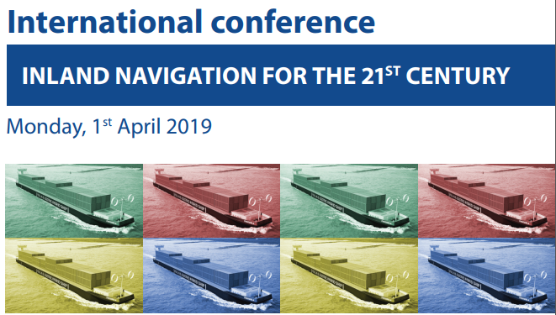
Lubomír Fojtů Waterways Directorate of the Czech Republic

Slide 2
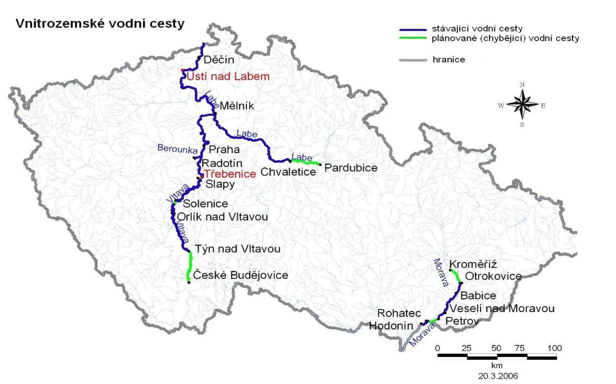
Waterway network of the Czech Republic – major bottlenecks
Improvement of navigation conditions on free flowing Labe - Plavební stupeň Děčín
Labe – stable navigation conditions
(cascade 21 locks)
Vltava
stable navigation conditions
(cascade 10 locks)
Class IV – the european standard of vessel parameters
Missing connection to Pardubice aglomeration
Freight volumes on CZ waterways are very low (< 1 mil.t.)
Major limitation – unstable draughts on free flowing Labe
long periods without navigation,
unstable service for shippers – shift to road transport
Notes:
Irop – prodloužení VC pro rekreační plavbu, program zatím není nastaven, přístavy lze efektivněji financovat ze sfdi (z hlediska administrativy)
2

Slide 3
W/L Roztoky - complies with the today´s TEN-T requirements!!!
1898
W/L Praha – Trója
W/L Podebrady, W/L Kolin
1902
1925
W/L Hořín
W/L Usti n.L, W/L Vrane n.Vl., W/L Lysa n.L.
1905
1935
W/L Dolní Beřkovice
W/L Brandys n.L.
1907
1936
W/L Obříství, W/L Roudnice n.L.
W/L Kostomlatky, W/L Srnojedy
1912
1936
W/L Praha – Štvanice, W/L Praha – Smíchov,
W/L Celakovice
W/L Pardubice
1913
1938
1974
W/L České Kopisty
W/L Stechovice - tallest loock chamber in Europe
Lch Veletov
1914
1945
1975
W/L Dolánky
W/L Štětí
W/L Lovosice
W/L Prelouc
W/L Klavary
W/L Velky Osek
W/L Kamyk
W/L Tynec n.L.
Lch Hluboka nVl
1901
1909
1919
1927
1940
1952
1962
1977
2013
W/L Miřejovice
W/L Hadík
W/L Nymburk
W/L Kostelec
W/L Hradistko
Artificial lake Orlik with a lift for small vessels
W/L Praha - Modřany
W/L Hněvkovice
1903
1911
1922
1932
1944
1962
1983
2017
1898
1898
1912
1926
1940
1954
1968
1982
1996
2010
2023
Today
4369 days
ck Waterways Directorate
1902 - 1918
5478 days
New Waterways Directorate
1998 - 2019
7914 days
1st Czechoslovak Waterways Directorate
1918 - 1949
1044 days
construction of the Bata Canal
1934 - 1938
7044 days
Coal transports on the Bata Canal
1938 - 1965
4435 days
IWT infrastructure under the responsibility of national committees
1949 - 1966
13890 days
Water Basin Managements created
1966 - 2019
6325 days
recreation and passenger transport on the Bata Canal
1995 - 2019

Slide 4
Czech access to the sea
Oder
Danube
Elbe
Strengths
Polish approach to their IWT
Weaknesses
Water conditions on the middle and upper Oder
Threats
NGOs
Opportunities
Positive results of the Feasibility study for the Oder-branch
Polish interest in the international cooperation
Great interest of the local authorities and potential users of the waterway
Strengths
Slovak interest in the international cooperation
Weaknesses
Austria
Threats
NGOs
Opportunities
Positive results of the Feasibility study for the Danube-branch
Possible connection directly from Morava to Vah passing the Austrian territory
Strengths
Existing waterway
Weaknesses
Bottleneck on the D/CZ border
Threats
Gesamtkonzept Elbe
Opportunities
International treaty of the Elbe
Fleet adapted to the local conditions
Czech territories in Hamburg
Gesamtkonzept Elbe
NGOs

Slide 5
East – East Mediteranean corridor of the core TEN-T network
Strategic corridor bottlenecks:
Unstabile draughts on Elbe, as cross-border issue CZ/BRD
Other bottlenecks:
Connection to Pardubice and Hradec Králové aglomeration and improvement of waterway to Prague
Low navigation draughts and clearances under bruidges on Vltava to Prague
Unsatisfactory performance of lock chambers
Unfinished implementation of RIS and cross border data exchange with BRD
Notes:
Irop – prodloužení VC pro rekreační plavbu, program zatím není nastaven, přístavy lze efektivněji financovat ze sfdi (z hlediska administrativy)
5

Slide 6
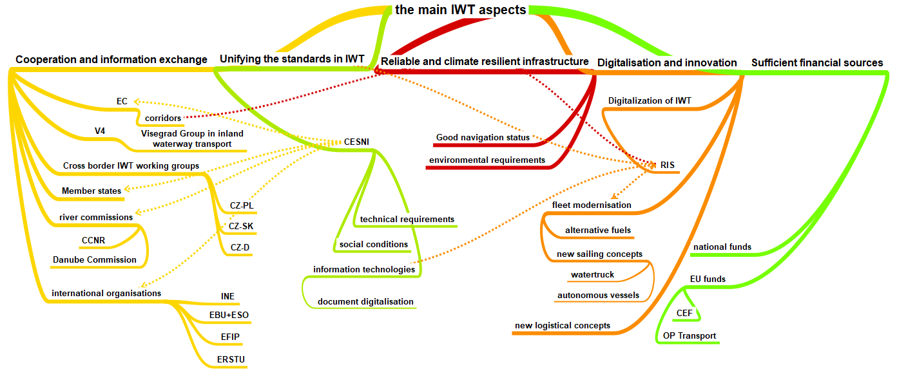
Need for information centres

Slide 7


New logistic concepts
Alternative fuel concepts
RIS
Reliable infrastructure
Better communication – information centres

Slide 8



Thank you
for your attention

