Slide 1
Chart Ferox, a.s. Děčín
LNG Terminal Hamburg

Slide 2
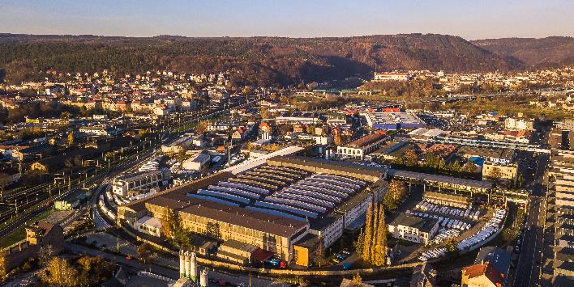
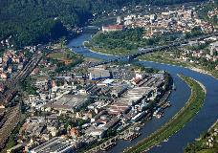
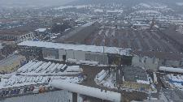

Chart Ferox – 75 years of manufacturing history
A premium leading European manufacturer of highly engineered equipment used in the production, storage and end-use of hydrocarbon and industrial gases.
History of Chart Ferox Facility – Děčín, Czech republic
1941 – 1945 Private company founded by Wilhelm Schmiding
2006 Ferox name changed to Chart Ferox, a.s.
2008 Chart Ferox, a.s. purchased Flow Instruments

Slide 3
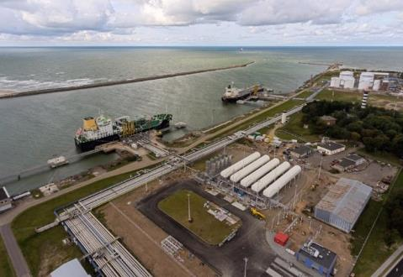
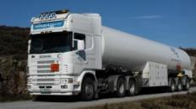
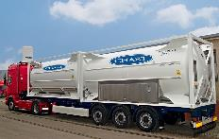
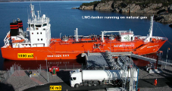
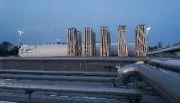
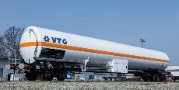
Coastal Receiving & Reloading Terminals
Multifunctional LNG terminal with distribution hubs
Trailer loading bay – intermodal transport
LNG carrier
Receiving terminal
Bunkering jetty – offloading & filling
Regasification plant – local gas supply
Railcar loading depo - rail transport

Slide 4
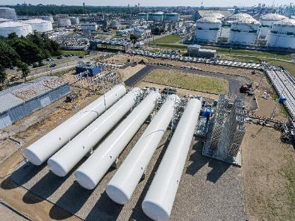
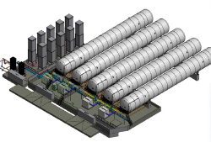
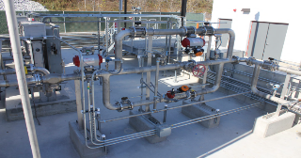
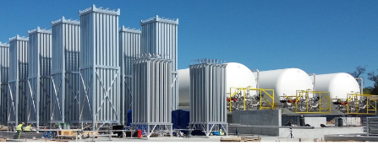
Regasification Stations & Terminals
Major infrastructure projects that enable offloaded LNG to be used for marine bunkering, small-scale distribution via road, rail or marine and re-gasified for local use.
Chart designed, built, installed and commissioned the complete cryogenic section at the LNG import and distribution terminal that has established the Port of Klaipeda as an LNG distribution hub for the Baltic region.
Chart Vacuum Insulated Pipework significantly reduces heat leak during LNG transfer and provides a functional life well beyond that of mechanically insulated pipe.

Slide 5
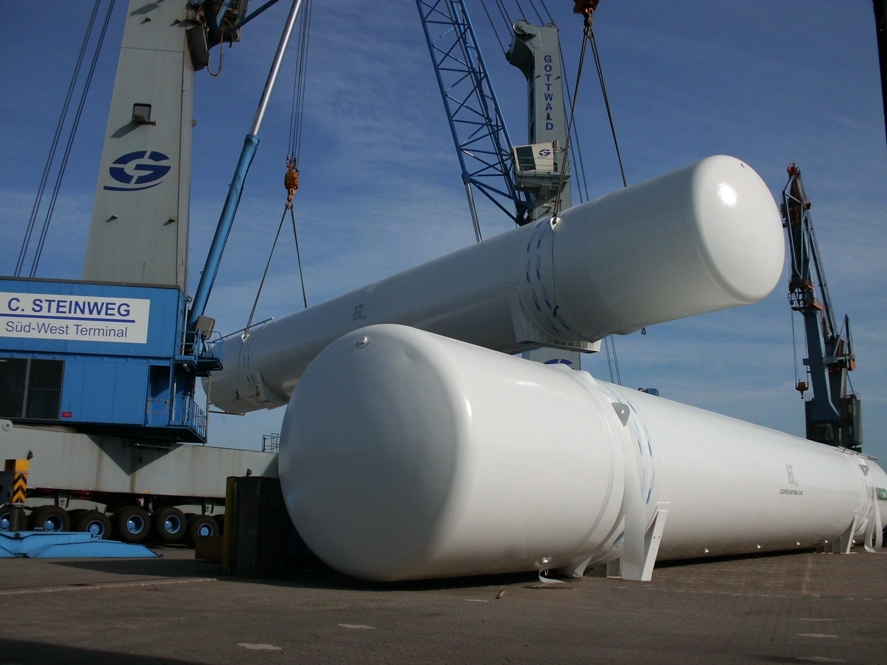
Chart Ferox – Transportation – Hamburg Port

Slide 6





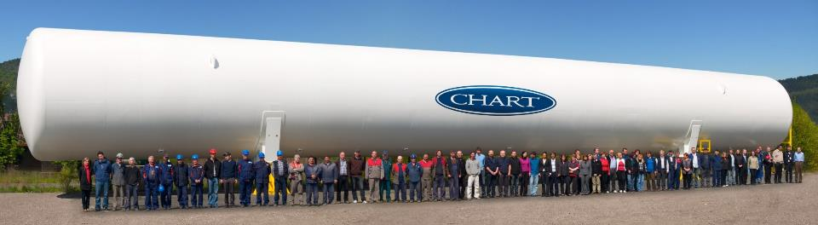
Thank You for Your Attention
www.chartindustries.com

