Slide 1

Good Navigation Status and
Non-Road Mobile Machinery Regulation
INLAND NAVIGATION FOR THE 21ST CENTURY
Prague 1 April 2019
Gernot Pauli
Chief Engineer
Kai Kempmann
Administrator for Infrastructure and Environment

Slide 2

01
BACKGROUND
GNS

Slide 3

Good Navigation Status | 1 / 10 | Background
Background
Good Navigation Status (GNS)
Good Navigation Status (GNS) is a concept to improve the European waterways to be part of a sustainable transport system
European Commission aims to promote and strengthen the competitive position of inland waterways in the transport system, and to facilitate its integration into the intermodal logistics chain

Slide 4
Good Navigation Status | 2 / 10 | Background
Background
Union guidelines for the development
of the trans-European transport network
(EU 1315/2013, Art. 15 (3))
a) Rivers, canals and lakes comply with the minimum requirements for CEMT class IV inland waterway and there is continuous bridge clearance
a) Draught not less than 2.50 m and minimum bridge clearance heights not less than 5.25 m
b) Rivers, canals and lakes are maintained so as to preserve good navigation status, while respecting the applicable environmental law

Slide 5

Good Navigation Status | 3 / 10 | Background
Background
Guidelines towards achieving a
Good Navigation Status
In 2015 the European Commission asked a consortium to further define the GNS together with the member states, river commissions and users
This GNS concept comprises so called “hard” and “soft” GNS components, GNS indicators based on TENtec data and minimum standards of a process on GNS development as well as a GNS definition
Results are published on the Guidelines towards achieving a Good Navigation Status*
* https://ec.europa.eu/transport/modes/inland/studies/good-navigation-status-guidelines-towards-achieving-good-navigation-status_en

Slide 6
Good Navigation Status | 4 / 10 | Background
Background
Second meeting of pan‐European Working Group
on Good Navigation Status 2017 in Brussels
        Objectives for rivers, canals and lakes shall be adapted in light of hydrology and morphology
        Draught or respective fairway depth and minimum bridge clearances shall be defined in relation to a reference water level
        Regional navigation shall be considered in the definition of regional objectives

Slide 7

Good Navigation Status | 5 / 10 | Background
Background
The correspondence group
        In 2017, DG MOVE suggested to the CCNR to set up a correspondence group on this matter
        Experts of 9 EU member states and representatives of the Danube Commission, the International Sava River Basin Commission and the Central Commission for the Navigation of the Rhine participate
        Output of the correspondence group and individual statements by the group or its members express expert opinion and not official positions of member states or river commissions

Slide 8
02
STATE OF WORK
GNS

Slide 9
Good Navigation Status | 6 / 10 | Background
Preliminary proposal by the correspondance group
Development of proposals for appropriate objectives for rivers and canals:
        Proposal for a GNS comprises 3 different types GNS A, GNS B and GNS C
        These 3 GNS are considered equal in terms of quality of navigation infrastructure
        Based on the idea, that today at most European rivers, maximum depth is already realized for all kinds of navigation conditions

Slide 10
Good Navigation Status | 7 / 10 | Background
Preliminary proposal by the correspondance group
Development of proposals for appropriate objectives for rivers and canals:
        Takes into account local differences in surface water characteristics and particularly in hydro-morphology
        Recognizes already existing regional, national and international stipulated waterway parameters
        Recognizes existing uses of waterways and traffic density as well as regional differences in markets such as bulk and container traffic

Slide 11
Good Navigation Status | 8 / 10 | Background
Preliminary proposal by the correspondance group
GNS on free-flowing and impounded river sections:
Example:
Free flowing sections: GNS AA
Impounded sections: GNS ABA

Slide 12
03
OUTLOOK
GNS

Slide 13
Good Navigation Status | 9 / 10 | Background
GNS SUB-GROUP
Sub-group on Good Navigation Status (GNS sub-group) set up under the Expert Group on Inland Waterway Transport (NAIADES II Implementation Group):
Task 1: Assess the relevance, effectiveness, efficiency, added value and coherence of the requirements for inland waterways set up in the relevant regulations.
Task 2: Formulate adequate requirements for IWW taking into account the different characteristics of waterways and propose recommendations for the future policy on TEN-T.
Task 3: Formulate proposals for the definition of GNS and development of common, harmonized guidelines/standards for GNS, including instruments for its monitoring.

Slide 14
04
Non-Road Mobile Machinery (NRMM)

Slide 15



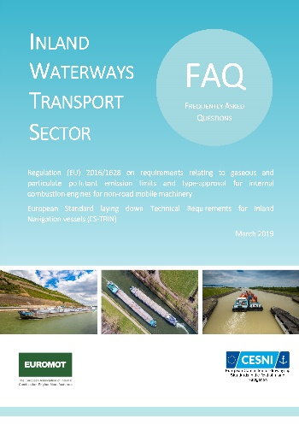
New emission regulations introduced by NRMM Regulation | 10 / 10 |
NRMM. Approach is driven by “placing on the market” of engines
=> type-approval certificate
Stage V: new engines categories (IWP/IWA) mandatory by 2019/2020 + exception of transition scheme (at the latest by 2022)
Alternative solutions: NRE, EURO VI or alternative fuels
(environmental and economic benefits)
Technologies available. Commercial products (stage V) will follow
(new products announced very recently by manufacturers)
Existing engine + after treatment system => can achieve similar performance as Stage V (but is not legally recognised as Stage V!)
ES-TRIN (Chapter 9) : Safety requirements for installation of engines on board. Approach is driven by “periodic inspection of the vessel”
=> vessel certificate
Regulation (EU) 2016/1628
NRMM
To help understand and interpret the applicable requirements to engines
=> FAQ document published by EUROMOT and CESNI (March 2019)
www.cesni.eu/en/technical-requirements/

Slide 16

THANK YOU FOR YOUR ATTENTION
Kai Kempmann
Central Commission for the Navigation of the Rhine (CCNR)
Palais du Rhin - 2, place de la République
CS 10023 - 67082 Strasbourg Cedex - France
+33 (0)3 88 52 20 06
k.kempmann@ccr-zkr.org
www.ccr-zkr.org

Slide 17
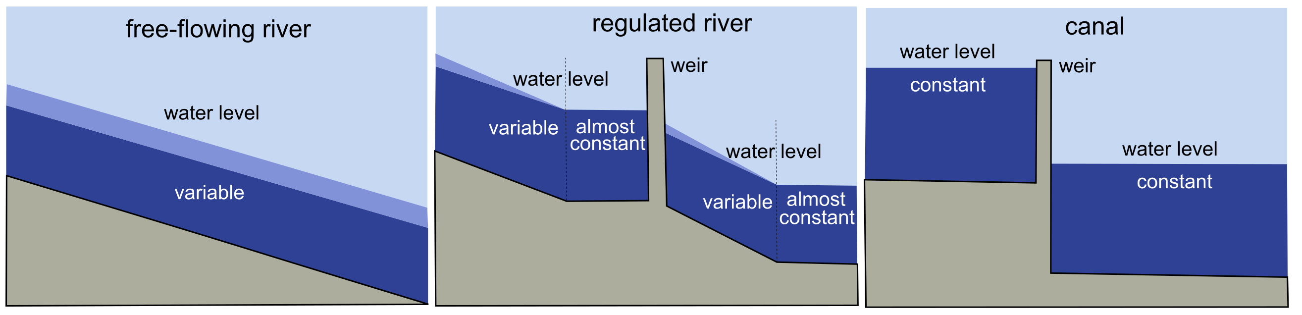
Proposals for appropriate GNS objectives | add.3 | Characteristics
Characteristics

